Slide 1

MLAI215- Predicting Home Improvement Sales with a Mass Retailer via TensorFlow
Dan Kopp, Charlie Morn, Matt Yates North Highland
July 2018

Slide 2
Natural Disasters… a Costly Emergency
In 2016 alone, natural disasters caused $153.9B of damage worldwide.
Source: EMDAT (2017): OFDA/CRED International Disaster Database
Notes:
https://www.flickr.com/photos/isdr/7460711188/in/album-72157628015380393/
https://reliefweb.int/report/world/annual-disaster-statistical-review-2016-numbers-and-trends

Slide 3
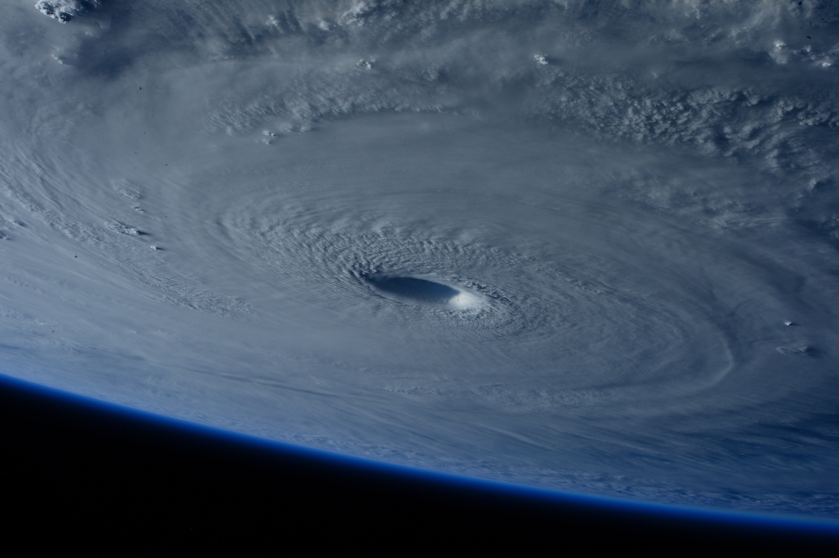
No One is Immune to Weather Emergencies
Are you prepared?
When a systematic disaster strikes, ask yourself, what do I need to meet my basic needs? How much would you have to purchase in the moment?
What if the store shelves are empty?
Royalty-free photo by NASA on Unsplash

Slide 4
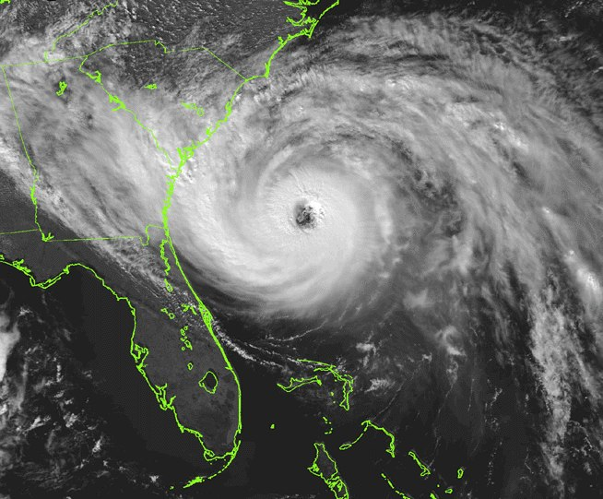
Empty Shelves Don’t Help Anyone
Opportunity
Challenge
What if a business could quickly react to storms to meet humans’ basic needs?
There are real-world constraints to getting the right product to the right location at the right time
Limited inventories in stores and DCs
Huge logistics costs
Small window of opportunity
Know what products will be in demand? – Very different product needs for wind vs flood events
How much product to send
Increased revenue
Increased customer loyalty
Improving the lives of many
Hurricane Hugo. Royalty-free photo from Wikimedia Commons.
Notes:
Vision:
“Empty shelves don’t help anyone!” What if a business could quickly react to storms to meet humans’ basic needs in times of disaster? The benefits are big:
Increased revenue
Build tremendous goodwill and loyalty with customers
Feel great about helping other humans
But there are real-world constraints to getting the right product to the right location the right time
Limited inventories in stores and DCs
Small window of opportunity
Huge logistics costs
How do we know what products will be in demand? – Very different product needs for wind vs flood events

Slide 5

Agenda
What is Emergency Response?
Business Case
Predicting Demand
Integration with Existing Processes
Results
1
2
3
4
5
Charlie Morn

Slide 6
1
What is Emergency Response?

Slide 7
What is Weather Emergency Response in Retail?
Effective retail emergency response depends on the seamless integration of multiple elements
COMMAND CENTER
Quickly and efficiently established command center
OWNERSHIP AND DECISION MAKING
Defined playbooks with rules of engagement
PRODUCT POSITIONING
Sales and weather-informed predictive inventory staging
TRANS / FREIGHT
DIVERGENCE
Pre-defined plays for situations such as no carrier capacity
COMMUNICATION
AND VISIBILITY
Quick and accurate dissemination of information to merchants, store ops, and field teams
IT SYSTEM
UPTIME
Backup/Disaster Recovery processes tested, etc.
STORE OPS
RESILIENCE
Labor Standard Operating Procedures (SOPs), to keep employees safe and stores open
CUSTOMER
ENGAGEMENT
Consistent communication messaging with customers through all channels
Notes:
John’s 8 point slide
TALKING POINTS:
Data work
Process work

Slide 8
There is Real Opportunity
In the words of retail leaders…
"We had $360 million of hurricane-related sales in 2011."
"Hurricanes put a significant demand on the transportation system and costs went up."
"Hurricanes Harvey and Irma drove demand, our teams sent over 11,000 truckloads of products."

Slide 9
2
The Business Case

Slide 10
Business Case, Hurricane Irma
North Highland’s Analysis:
Losing 40-60% of incremental sales due to out of stock issues
Sending millions of dollars of product to the wrong locations
Could avoid millions in logistics costs for product not in instant demand
Source: Firms’ Q3 2017 10K and investor calls
Notes:
THD
https://www.denverpost.com/2017/11/14/home-depot-post-hurricane-sales/
https://www.wsbtv.com/news/2-investigates/home-depot-destroys-1-million-pounds-of-supplies-in-wake-of-hurricane/691725218
https://nypost.com/2017/11/14/home-depots-results-get-a-boost-from-hurricanes/
https://seekingalpha.com/article/4124824-home-depot-hd-q3-2017-results-earnings-call-transcript
Hurricane-related sales in the quarter were approximately $282 million
“gross margin on the hurricane-related sales was considerably less than our company average”
“$104 million of hurricane-related expense in the quarter for items like people cost, increased security in our affected stores, and storm damage”
http://ir.homedepot.com/~/media/Files/H/HomeDepot-IR/2018_Proxy_Updates/HD_AR_Soft-Copy.pdf
Hurricane-related sales contributed approximately $662 million to net sales in the second half of fiscal 2017.
We also incurred approximately $170 million of hurricane-related expenses in the second half of fiscal 2017 (25.6% of revenue)
LOWES
https://newsroom.lowes.com/inside-lowes/emergency-command-center-leads-lowes-hurricane-response/
https://newsroom.lowes.com/news-releases/q3-2017-sales-earnings/
Hurricane-related sales in the quarter were approximately $200 million
WALMART Q3 call
We estimate hurricane-related impacts benefited comps by 30 to 50 basis points (2.7% comp on 77,724 MM = $233 to 339 MM)
Recent hurricanes benefited top line results, but negatively impacted gross margins and SG&A. We estimate the net result was a negative impact to segment income of approximately $150 million.

Slide 11
What makes this different?
An integrated platform of big data, machine learning, and scalable horsepower means we can go deeper, faster, and more tailored to our needs than ever before.

Slide 12
3
Predicting Demand
Let’s Get Technical, Technical

Slide 13








Google Cloud Platform Made it Possible!
Robust Ecosystem
Everything we needed
Big Data platform
TensorFlow / CloudML
Kubernetes
Cloud Storage
High Performance
Low Cost
BigQuery
Cloud Storage
Cloud Machine Learning
Stackdriver
Cloud Shell
Cloud SDK
Kubernetes
Notes:
Talk about why no use of Dataflow or Hadoop. Achieved the end goal with client’s constraints
Specifically, explain that we picked Kubernetes because of client constraints but Kub was still an effective tool.
Maybe quip that if we had to do complex shuffles/combinators we would basically have rebuilt MapReduce
Demo weather scraping? 74B records in ~13 hours?
TensorFlow, Kubernetes and Python images from freepngimg.com

Slide 14
Weather Data Orchestration
Data Availability
Actuals that are easily available and processed are incorrect – meters fail during major events.
Historical forecasts are available on the NOAA website, but require processing
File Workflow
1. Generate URL from datetime
2. Download from NOAA Process in one of two industry-specific programs
3. Export to CSV
4. Stream records to BigQuery
24 files per day x 10 years = 150B records total
Enter Docker + Kubernetes
Docker lets us build an easy-to-deploy custom environment for processing files
Kubernetes acts as traffic controller, managing compute resources and queues across 500 active CPUs to process

Slide 15
Kubernetes Overview
We need to process lots of data. It needs to be inexpensive, fault tolerant, and massively parallel.
We also need to meet client security and environment requirements
Framework Design
Kubernetes gives us a framework that can process hundreds of parallel threads in multiple customized environments.
We create a container that can process the data that is loaded into hundreds of pods. A separate redis pod handles the fast queueing system to keep track of which files still need to be processed.

Slide 16
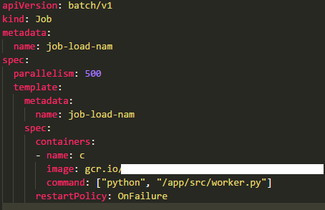
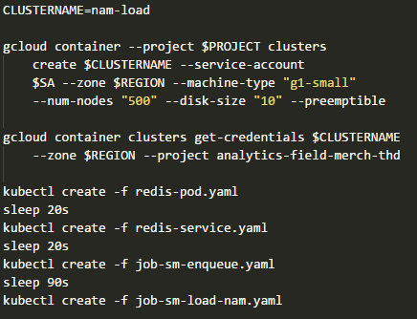
Spin it Up
Parallelism Made Easy
Starting a Kubernetes cluster is straightforward, and the hard behind-the-scenes work is handled for you. We configure the pods through YAML and kick off with a simple Google Cloud SDK command

Slide 17
What are we predicting?
We chose to predict retail sales dollars within more than 300 product category groupings for the “time-pools” immediately before and/or after a natural disaster
Notes:
SKU pooling (demand stop gap), shingles example
This is a regression problem
In the event of a storm, demand will be stable for an initial period of time. Eventually, once people know where they storm will be, some amount of pre-strike/panic buying occurs. On the day the storm hits, the real impacts are felt and demand sharply spikes. Demand builds for a few more days as people assess their needs, and trails off somewhat quickly and eventually levels back at baseline.

Slide 18
Prediction Methods
We considered traditional statistical timeseries analysis, like exponential smoothing and ARIMA, but ultimately turned to neural networks (NN) due to high-accuracy and available architecture
Demand
Replenishment System Forecast
Days of Stock On-Hand
Notes:
Risk of “bull whip” effect…
If the store starts with about a week of stock on-hand, normal replenishment can ironically lead to both unmet demand and also overstocking situations. (In this example, trucks ship with predicted inventory on 9/1, 9/8, 9/14, 9/17, and 9/22). The 9/1, 9/8 trucks are great: they keep the store stocked with normal inventory, meeting baseline demand. The 9/14 truck, however, is woefully inadequate (small blip in on-hands). Even though the replenishment system ships over 3x the normal inventory, it’s not enough to keep up with demand. Demand throughout the week is not met, until well after the event when a second shipment arrives. Now we’re in a reverse situation, though: demand is still clearly high and the system wants to meet it. Large amounts of stock are shipped to the store on 9/17 and 9/22, but it’s too late. The people who needed the product most have gotten it elsewhere, and the store has failed to support the customer’s demand needs.

Slide 19
Choosing a Network Type
Choosing a network type
The team spent significant time finding the most predictive model architecture. We experimented with several recurrent network setups, but ultimately settled on deep feedforward with event-time pooling
Event Timeline:
Baseline Sales Time Period
Pre-Strike
Post-Strike
Time _{-32 days}
_{(configurable)}
Time _{-4 days}
Time _{0 days}
Time _{+N days} _{(configurable)}
Notes:
Experimented with RNN
Landed on FF NN

Slide 20









Demand Prediction Pipeline
Build Features and Labels
Train Model(s)
Output Predictions
(and more)
Kubernetes
BigQuery
Cloud Storage
Cloud Machine Learning
BigQuery

Slide 21
Building 1500 Features and Labels
Weather/Geo Data
72 Billion historical observations and future forecasts of wind, rain, pressure, soil moisture, solar radiation, vegetation type/rate, and many more from NOAA and NLCD
Demographics
Geographically-based demographic and psychographic attributes from census data
Client Data
10 years of product sales and inventory across all stores, grouped by product attributes
(and more)
Kubernetes
BigQuery
Cloud Storage
Notes:
Talk about how to use BQ for feature modeling. Very powerful vs. trying to do this in pandas. Major value here. SQL+UDF == way more power to build candidate features.
They believe that there’s a lot of value in using GBQ to do feature engineering for ML. Can we show a query/UDF/etc. that we used for (for instance) geofencing, etc.?

Slide 22
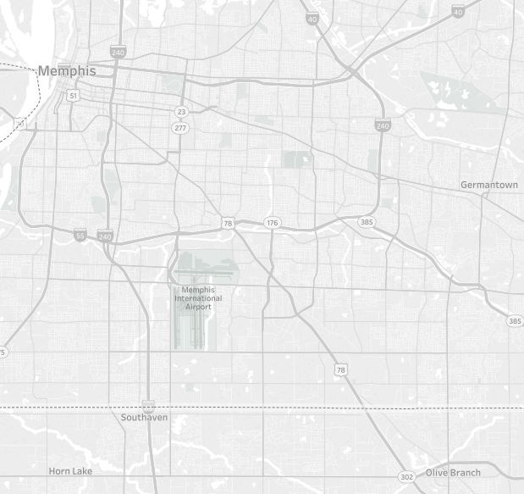
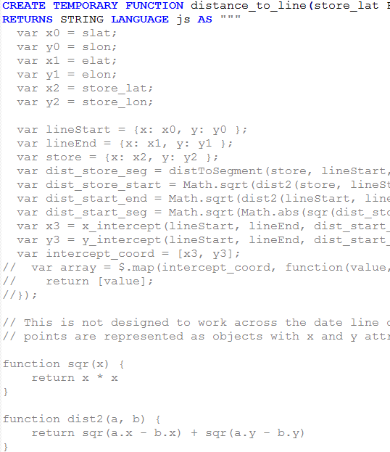
Feature Engineering in Big Query (SQL+UDF)
Tornado Feature Illustration
Store
Store
Distance to path
& rank vs other stores
(and more)
Store
BigQuery
Cloud Storage
Tornado Path
Kubernetes
Notes:
Talk about how to use BQ for feature modeling. Very powerful vs. trying to do this in pandas. Major value here. SQL+UDF == way more power to build candidate features.
Example here is distance to tornado path and rank of distance along path
They believe that there’s a lot of value in using GBQ to do feature engineering for ML.

Slide 23
Training Models
Single vs. Multi-Output
We could either design and train one model for each label (product category) or use a multi-output model. Ultimately, we found slight accuracy improvements from single output (likely due to higher network bandwidth)
TensorFlow and Keras
Our initial RNN implementations were in TF. As we desired to rapidly experiment with model architectures we moved to Keras (with TF backend) for rapid prototyping
Cloud Machine Learning
Notes:
Discuss TF vs Keras and tradeoff with client maintenance long-term

Slide 24
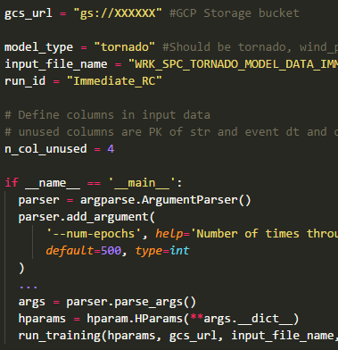
Hyperparameter Tuning in ML Engine (CMLE)
Exploring Hyperparameter Space
We were able to tune selected hyperparameters across ~100 training experiments with CMLE on customizable hardware to discover the ideal model
Batch size
Learning Rate
Number of layers
Unit size and shape
Activation Function
Cloud Machine Learning
Notes:
How you used leveraged CMLE to drive auto-tuning. Run 1000's of permutations without deployment complexity.
In general, take the opportunity to go deeper technically in some areas. Talk about how we loaded data into TF, etc.
Discuss regulation
Stopping early on validation set
Drop out
Holdout

Slide 25
Demand Prediction Accuracy
Results
The client and team were pleased with the predictive power of the models, measured against a holdout data set
Notes:
Mention pitfalls and lessons learned?
Possibly talk to the skill-fullness of features and how this would be super complex to model with a static algorithm.

Slide 26



Deploying and Operationalizing ML
Container
Registry
Cloud ML

Slide 27
4
Integration with Existing Processes

Slide 28
Tunable Parameters
Real-time tuning is made possible through exposed configuration parameters
Parameter | Value
Fill Demand with Store Preference SKUs | 1
3-Day Cumulative Precip Threshhold kg/m2 | 40.66
Max Wind Gust Threshold m/s | 26
Years of Weather History | 10
Relevant Weeks Before Wind or Rain Event | 4
Inventory Days of Supply Minimum | 2
Days prior to an event to consider for pre-strike demand | 4
Ratio of data to put in holdout set | 0.1
Number of Pallets per Truck unstacked | 26
Truck Full Round Up Percent | 0.8

Slide 29
A Sales Prediction is Just the Beginning
Gross Category Sales Prediction
Individual SKU Selection
Store Inventory Check
In-flight PO
Check
DC Inventory Check
Pallet Rounding
Net SKU Sales Predictions
Example for a Store:
$10k in Generators
$6.3k in 5500W
$2k in 5500W
$1k in 5500W
In-Stock
2 pallets of 5500W
$3.5k 5500W
$3.7k in 7000W
$1k in 7000W
None
In-Stock
1 pallet of 7000W
$2.4k 7000W

Slide 30



Human in the Loop
Approve or Adjust Sales Prediction
Cut Purchase Orders
Pack and Send Trucks
Humans (merchants, field teams) must sanity check and approve or adjust prediction based on expertise and knowledge on the ground.
The prediction must then be converted into a format that is easily consumed by supply chain systems for fast execution.
Trucking logistics play a major role in quantities shipped, so take that into account as well
(i.e. don’t ship less than ¼ truck to a store).

Slide 31
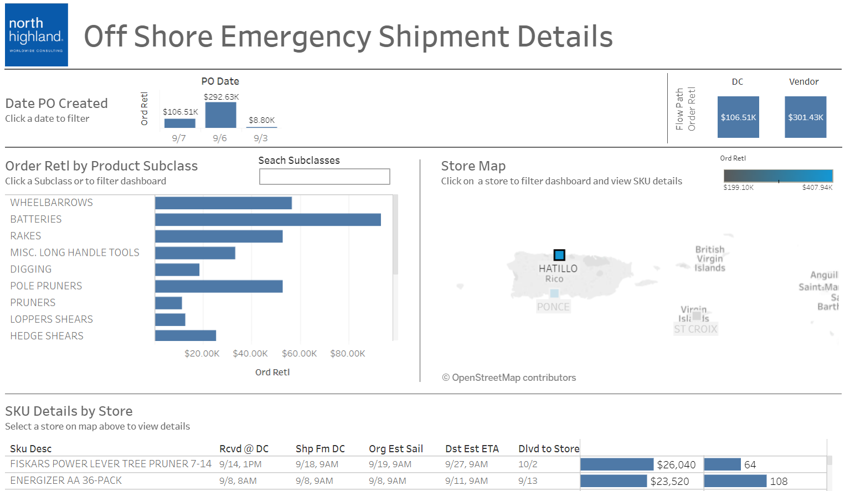
Tracking In-Flight Activity
Why it Matters:
Knowing when millions of dollars of in-flight shipments will arrive at stores is critical to meeting customer demand.
If product will be arriving soon, store employees can manage customer expectations accordingly, and plan staffing to the product off trucks and on to shelves quickly.
Off-Shore Emergency Shipment Details

Slide 32

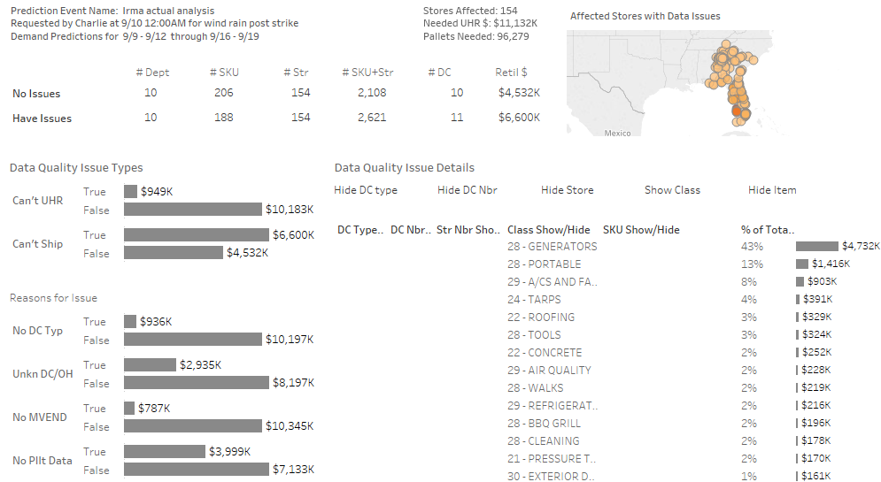
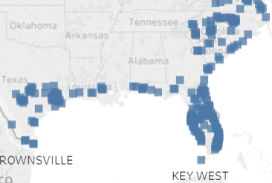
Managing Data Quality
Why it Matters:
Data isn’t perfect. Without insight to accuracy, assumptions, and missing data, companies do not know when to rely on good information, and when to fall back to other means.
Data quality understanding is built-in.
Data Quality Tracker

Slide 33
5
Results

Slide 34


Demos
Weather Data
Pallet and Truck Recommendations
Tracking

Slide 35



Next Steps
The story doesn’t end here. Our client is committed to integrating and improving this solution.
Notes:
Clean up data issues
Tune all the knobs
Pilot this year

Slide 36
Putting it all together.
Emergency Response is won in the off-season.
OFF- SEASON
PRE- SEASON
STORM SEASON
Develop rules of engagement.
Have a dry-run.
Deploy effective emergency response.
Notes:
We discussed
bringing it back to the opening hook
Have people think about how this relates to your industry
Think about how they can help in natural disasters

Slide 37
Contact our team to discuss further
Dan.Kopp@NorthHighland.com
Charlie.Morn@NorthHighland.com
Matt.Yates@NorthHighland.com

